Slide 1
Sandy Hill Community Liaison Committee
Oasis Program
March 19, 2024

Slide 2
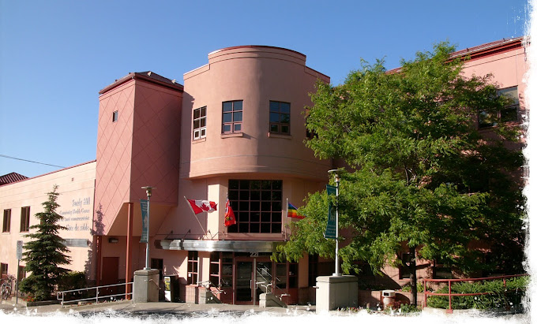
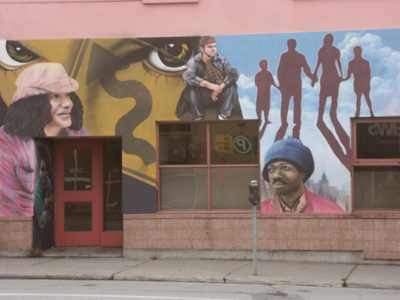
Sandy Hill CHC
What is offered
Primary care clinic for general public
Health promotions programming
Primary care for complex urban population - offers same day access to low- barrier full-spectrum (women's health, gender affirming care, palliative chronic disease management, HIV HCV treatment patient centered, trauma-informed, team-based primary care
Rapid access to mental health and use disorder treatment (diagnosis, at home medical detox, anti-craving medications, counseling, peer support groups, community resources, linking to detox and rehabilitation programs and after-program transitional services).
Mental Health and Addictions Services and Supports
Consumption and Treatment Site (CTS)
Peer facilitated Drop in
Drug Checking Services

Slide 3
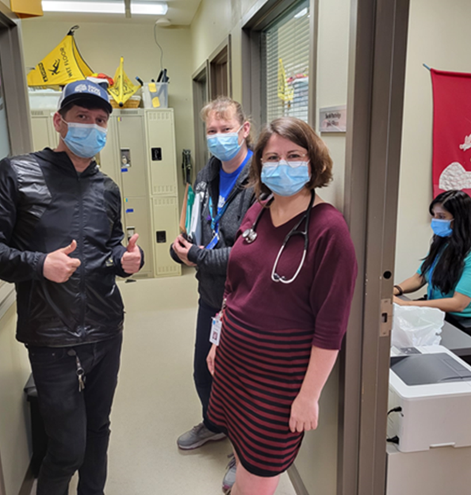

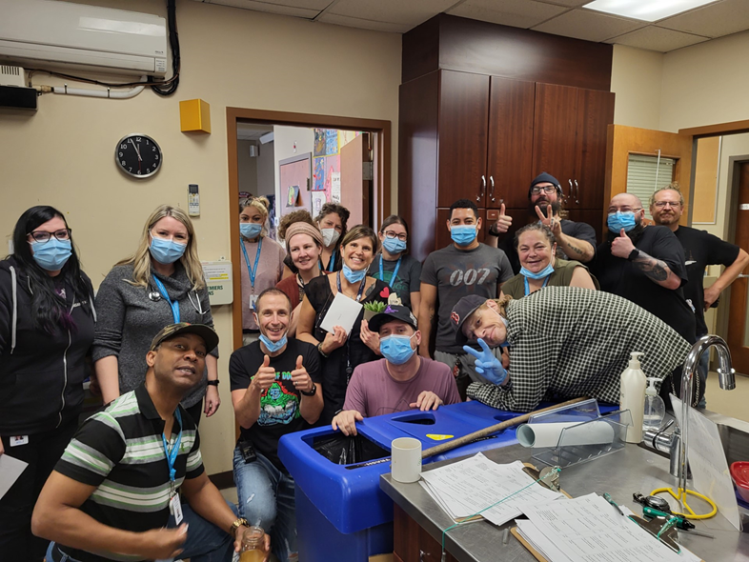
OASIS Clinic Program
Interdisciplinary Team
• Physicians/Nurse Practitioners
• Nurses
• Social Workers
• Harm Reduction Workers
• Peer Workers
• Psychiatry (Wednesdays only)
Hours of Operation
Oasis Medical Clinic - 9-5pm, Mon-Fri
CTS and Drug Checking – 8am-8pm, Mon-Sun
Drop In – 12-5pm, Mon-Fri
Notes:
In 8 months of this year the medical clinic has seen 922 unique patients, 5314 encounters
Drop In –approx. 1300 clients/mth
Daily clean up patrols

Slide 4
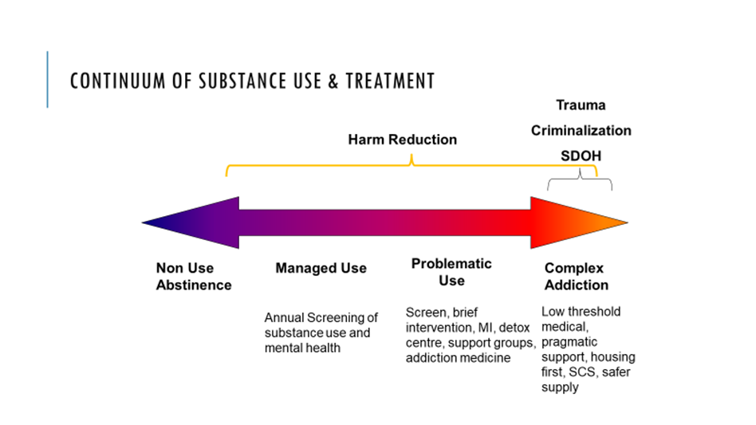

Slide 5
Rapid Access to Addictions Medicine
•RAAM clinics are drop-in clinics for people looking to get help with high risk substance use and addictions.
•This includes people who want to try medical assistance to reduce or stop their substance use. They may experience frequent intoxication or overdose symptoms, as well as unpleasant withdrawal symptoms when attempting to reduce or stop their substance use.
•RAAM clinics are also for people who may have substance-related health issues, such as hepatitis, pancreatitis, or infections, among others.

Slide 6
Opiate Agonist Therapy (OAT)
•Opioid Agonist Treatment (OAT) (the use of long-acting medications to treat withdrawal and prevent relapse) is recommended as a safe and effective way to treat addiction/withdrawal management.
•OAT has been shown to reduce overdose mortality and to reduce rates of injection-related infection.
Rapid expansion in access over past 20 years
  All federal prisons and most provincial/territorial correctional settings
  Approximately 15% of all federally incarcerated individuals now receive OAT
Russell, C., Nafeh, F., Pang, M. et al. Opioid agonist treatment (OAT) experiences and release plans among federally incarcerated individuals with opioid use disorder (OUD) in Ontario, Canada: a mixed-methods study. BMC Public Health 22, 436 (2022).
OAT formulation for incarcerated persons expanded
  Methadone
  Buprenorphine-naloxone (Suboxone)
  Extended-release injectable buprenorphine (Sublocade)

Slide 7
Oasis Budget
CTS is approx. 10% of Centre’s budget

Slide 8
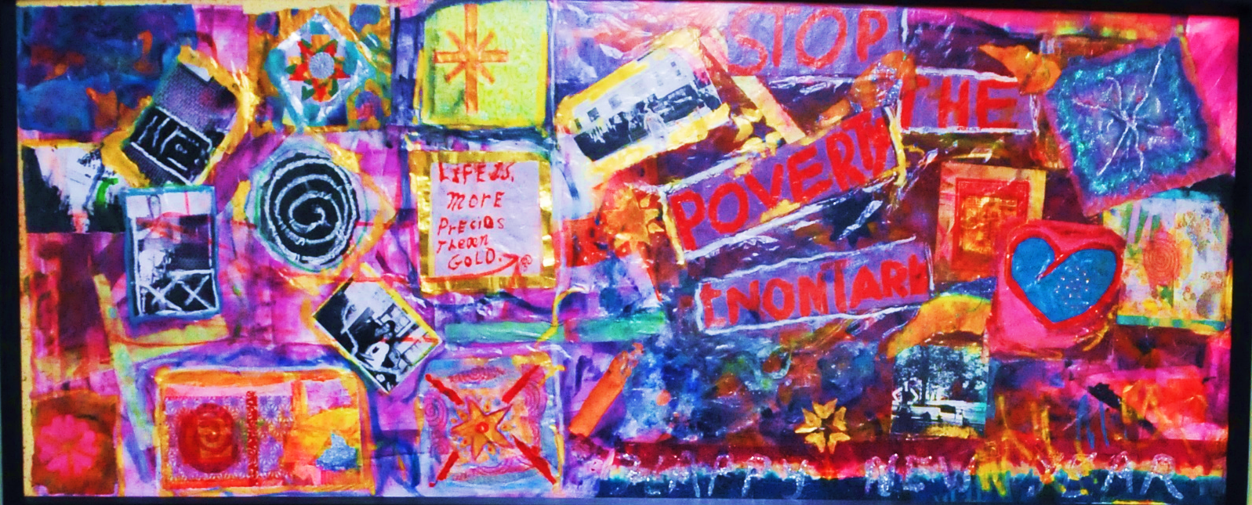
Our clients
16yrs +
People who are unhoused
People living with or at risk of HIV/AIDS and hepatitis C
People who inject drugs and/or smoke crack or crystal meth
People involved in sex work
Concurrent mental illness
Indigenous
Brain Injury
Collective art project by community members

Slide 9
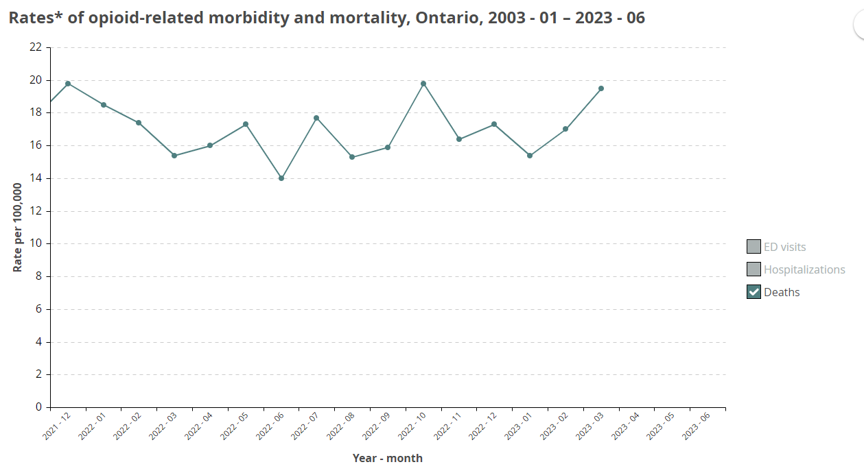
Interactive Opioid Tool | Public Health Ontario

Slide 10
Supervised consumption Sites* in Canada
January 2016
March 2023
A hygienic environment where people can inject pre-obtained drugs under the supervision of health care professionals (nurses, social workers, community workers, etc.)
Health teachings, primary care, OD intervention
Referrals to community agencies, substance use treatment and other health and social services
Building trust
*does not include Overdose Prevention Sites/Urgent Public Health Need Sites
38
2
Number of exemptions granted by Health Canada under section 56.1 of the Controlled Drugs and Substances Act
Notes:
*FRED’s STORY: About to inject o﻿n street corner -
In 2015, the Coalition of Nurses and Nursing Students for Supervised Injection Services was launched. The goal of the coalition is to bring together nurses and nursing students who support the full recognition and implementation of supervised injection services as health-care services for people who use drugs in Canada. Members of the coalition are committed to:Raising awareness on SIS among the nursing community and the general public
Advocating for the implementation of SIS as part of a harm reduction framework
Supporting the coalition by mobilizing support and participating in activities

Slide 11
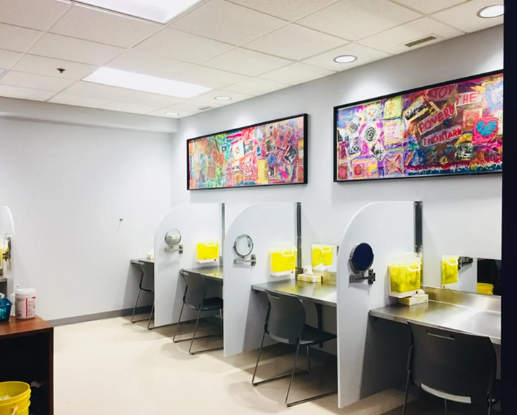
Supervised Consumption and Treatment Site at SHCHC
Application granted in July 2017
Fully operational on April 16, 2018
2019 Introduction of Fentanyl into the drug supply
2020 Pandemic
  Temporarily decreased services from 5 to 3 booths
Aug 2022 – service disruption for 1 week due to construction in CTS
September 2023, CTS resumes its 12 hr services, 7 days/week as per contract with MOHLTC

Slide 12
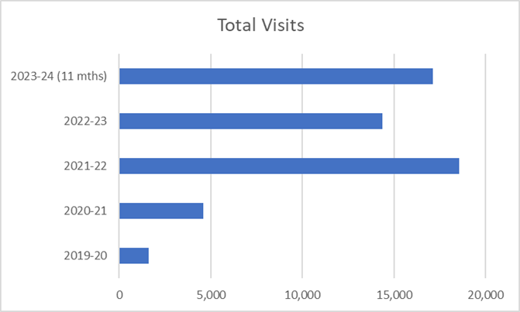
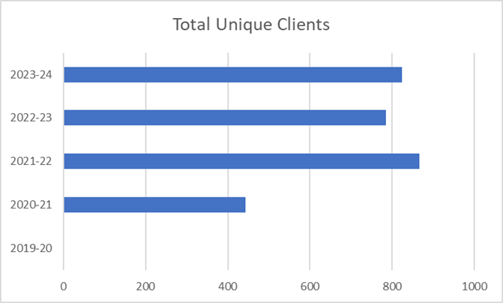
Utilization Statistics
Total number of clients remain relatively the same – approx. 800 unique people use the services, but the number of times they use the service has increased
Between April 1, 2023- Feb 29, 2024 – 17, 711 unique visits
Busiest time – 8-5pm

Slide 13
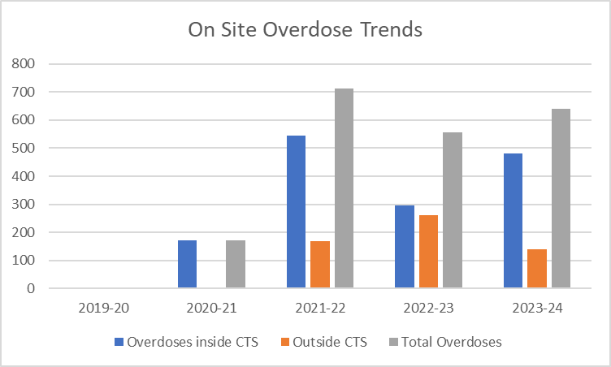
Overdose Trends at the Site
Total visits that experienced an overdose
2023-34 – 4% (641)
2022-23 – 3.9% (556)
Overdoses that occurred outside the CTS
      2023-24 - 22%
2022-23 - 47%
Of note - Supervised Consumption and CTS’s in Ottawa reversed 1100 overdoses in 2022; SHCHC’s CTS reversed 556 of those accidental overdoses.

Slide 14
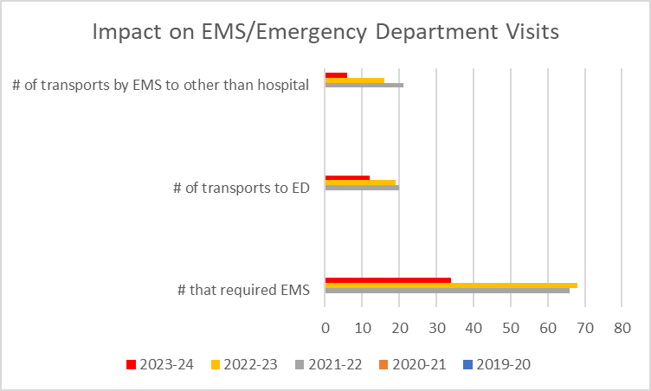
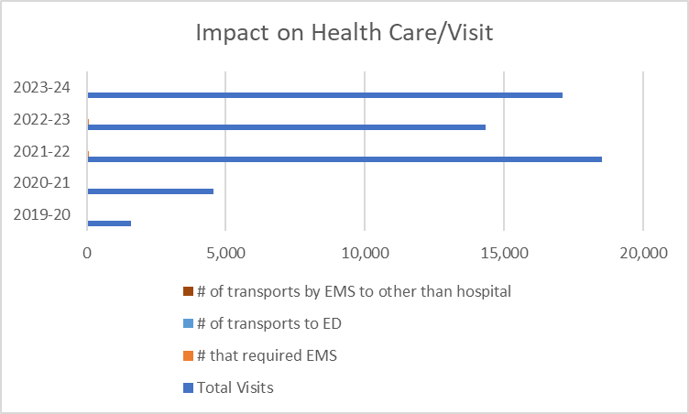
Impact on the Health Care System
Overdoses that resulted in call to EMS
  2023-24 - 0.2% (34)
  2022-23 – 0.5% (68)
  2021-22 – 0.4% (66)
# of persons transported to Emergency Dept
  2023-24 - 0.07 % (12)
  2022-23 - 0.1% (19)
  2021-22 - 0.1% (20)

Slide 15
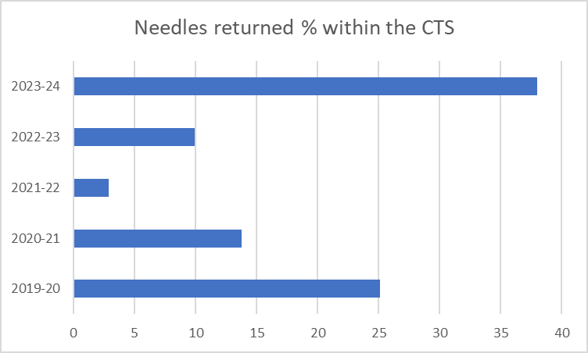
% of Needles Returned to CTS
38% of all needles distributed are returned in the CTS this yr to date
This excludes the Needle Hunter Program as well as the external box to the building – also run by the City of Ottawa

Slide 16
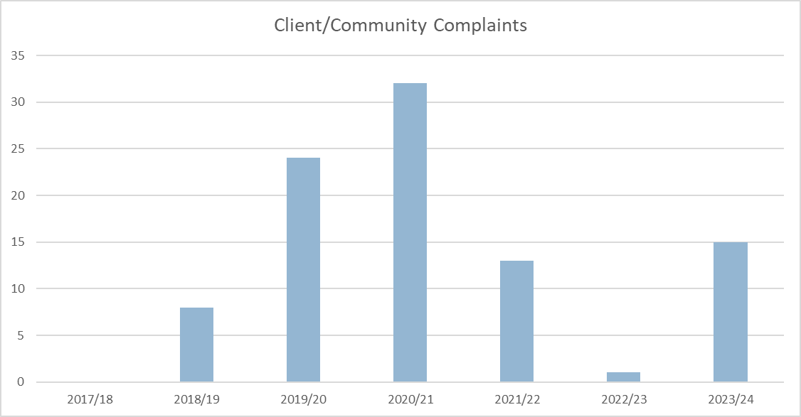
Complaints

Slide 17
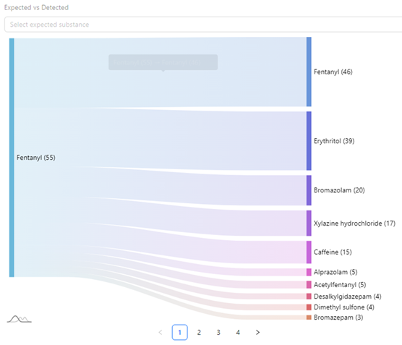
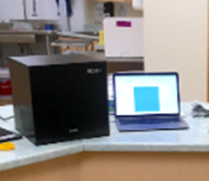
Drug Checking Services
Introduced to the Centre in October 2023
Ramen Spectrometer
On the spot harm reduction education
522 scans to date
Open to public 8am-8pm
67 samples tested in February

Slide 18
Recent Updates at the CTS
Feb 27th, 2024 – CTS services were paused until further notice following staff reporting brief periods of being unwell after being exposed to vapors (during preparation) or smoke by clients smoking drugs in the washrooms.
MOL has confirmed our precautions and are working with us along with MOH to recommend appropriate ventilation for the CTS and washrooms.
In the interim, we continue to provide health care, outreach, community clean up, mental health and addictions counselling, respite and harm reduction support and services to the community.
For those individuals requiring the services of a supervised consumption site, we are directing them to the following sites along with using the washroom facilities at Belong Ottawa:
Supervised Consumption Site Locations | Days | Time
Ottawa Public Heath – Supervised Consumption Services 179 Clarence St. | Monday to Friday | 9 am to 5 pm (last call 4:30pm)
Ottawa Inner City Health – ‘The Trailer’ at Shepherds of Good Hope 230 Murray St. | 7 days a week | 24 hours
Somerset West Community Health Centre (temp outdoor location) 55 Eccles St | 7 days a week | 8:30am-7:30pm

Slide 19
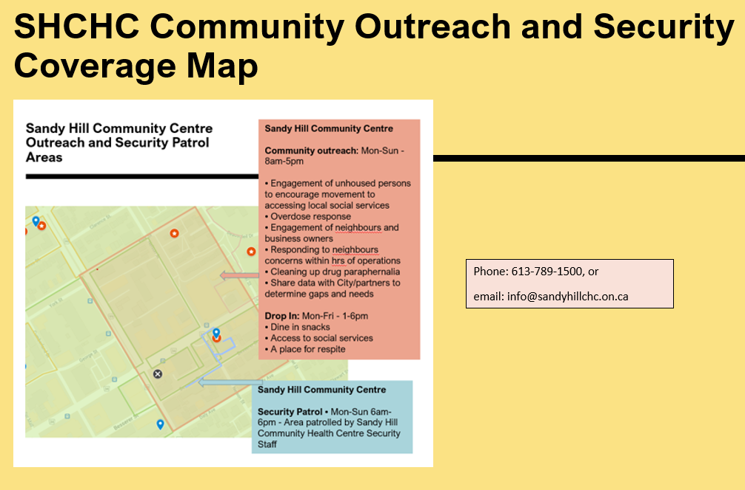

Slide 20
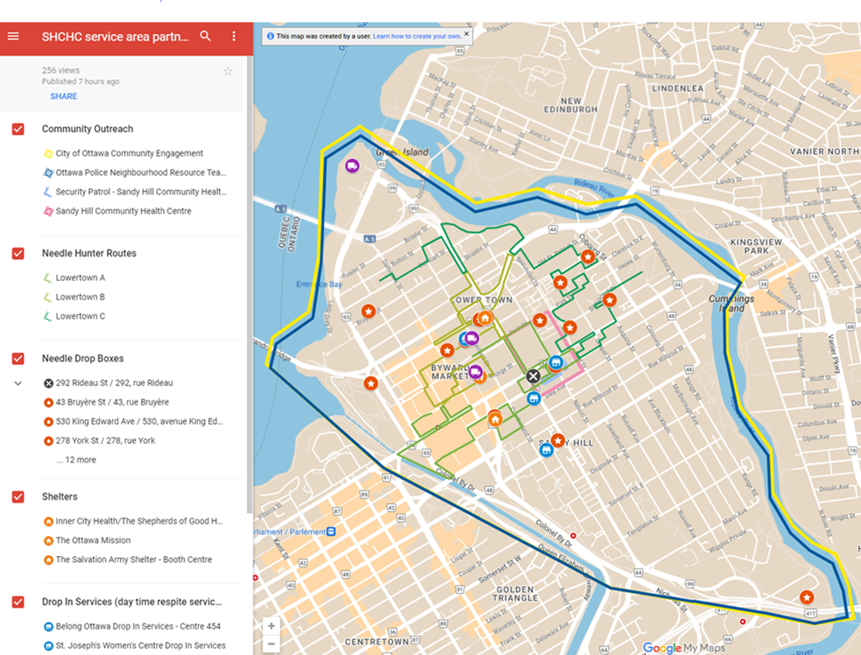
We are not alone…. reference for community service partners
The virtual interactive report is available here: SHCHC service area partner resources - Google My Maps

Slide 21
Questions?
Robin McAndrew – Executive Director, Sandy Hill CHC
rmcandrew@sandyhillchc.on.ca
613-789-1500
Wendy Stewart - Director - Oasis Program
wstewart@sandyhillchc.on.ca
613-789-1500 or 613-712-0301
Program Manager, Derrick St John
Ph: 819-209-1710
Email: dstjohn@sandyhillchc.on.ca

