Slide 1
CSSD / COMMUNITY ENGAGEMENT TEAM (CET) Sandy Hill Community Liaison Committee Presentation
Feb, 2024

Slide 2
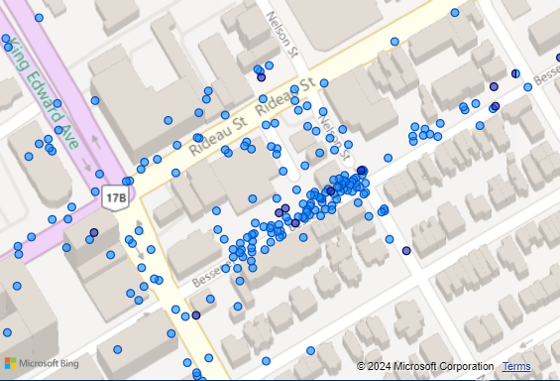
What we’ve seen (May 1st – Nov 30th 2022)
Activities
6231
814
1768
Interactions
Interventions
Street Hazards
Interactions
Open Usage 471
Wellness Check 531
Interventions
Housing 236
Health (Physical) 127
911 Calls 27

Slide 3
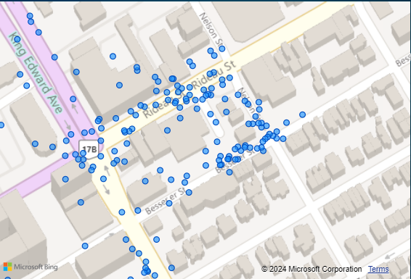
What we’ve seen (May 1st – Nov 30th 2023)
Activities
2924
343
1176
Interactions
Interventions
Street Hazards
Interactions
Open Usage 258
Wellness Check 300
Interventions
Health (Physical) 83
Housing 75
911 Calls 32

Slide 4
How to reach us!
Working Hours: Monday-Friday 8:00-4:00pm
Email: Communityengagement@ottawa.ca
Phone: 613-552-6759
CSSD Coordinator Lynea Finn
Email: lynea.finn@ottawa.ca
CSSD Project Coordinator Hana Mohamed
Email: hana.mohamed1@ottawa.ca

