Slide 1
Sandy Hill Community Liaison Committee Presentation
Introduction to Belong Ottawa
Programming at 454 King Edward
Data
Conclusions and Implications for 454

Slide 2
OUR MISSION
We provide safe spaces that connect people and create community.
We offer programs that address basic needs and foster dignity, wellness and hope for all.
OUR VISION
An inclusive community where no one is marginalized and everyone is valued and supported.

Slide 4
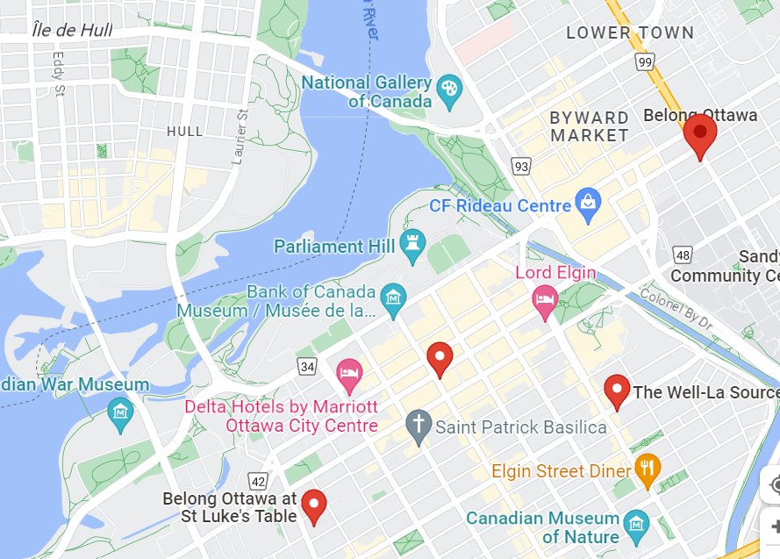
3 Sites

Slide 5
Core Funding from City of Ottawa : $1,358,736* 2023 Budget Revenue by source (all programs) including additional payments during the pandemic from Social Service Relief Funding for extraordinary costs and programming 74% expenditure is staffing

Slide 6
Social Assistance Income
ODSP for single person $1,308
OW - $733
OW | Basic Needs | Max Shelter | Total
Single | $343 | $390 | $733
ODSP
Single | $752 | $556 | $1,308
Notes:
Why do we need our programs : poverty. Advocate and campaign for Guaranteed Basic Income

Slide 7
2022 – All Programs
800 Unique individuals served
400 Individuals per day (~ 130 @454)
Centre 454 serves people who are unsheltered, living in shelters, and living in rooming houses in the neighbourhood.
104,000 Contacts/total visits per year ( open ~260 days per year)
Significant increase in numbers of people seeking support, particularly for food. Summer 2023 saw new group of people seeking asylum.
100 meals per day prepared, lunch starts at 12:00; running out of food at 12.30. Cannot meet demand for food.

Slide 9
2023 - average of one overdose per day significant change during 2023. Prior to this an overdose was an unusual occurrence. Incidents at 454 King Edward 2024 : 1st January - 17th February
EMS calls = 27
Monitored at 454 = 8
To Shepherd’s Emergency = 8
Transported to ED = 11
To note: the sent to ED # is high compared to the average month in 2023, because we had 8 overdoses on one day in January, so we sent people to the ED due to our limited capacity to safely monitor.

Slide 10
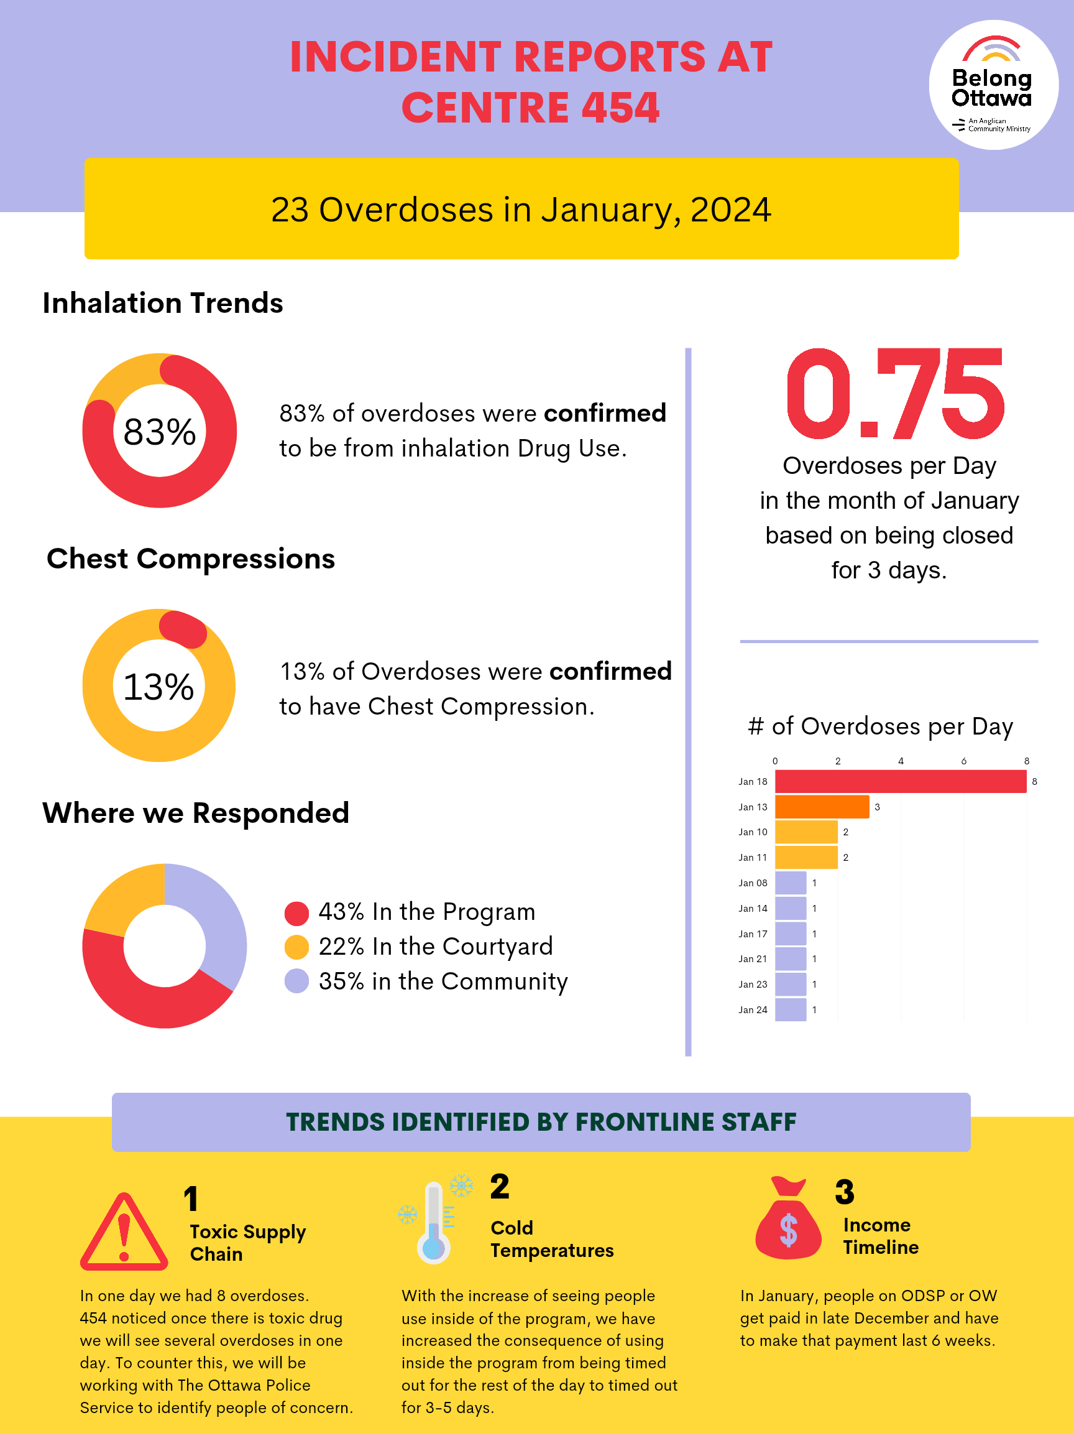

Slide 11
Number of overdoses has created an increasingly difficult environment for staff and participants of 454
Struggling to meet demand for food
Increasing numbers of people, specifically people seeking asylum, means our space is extremely crowded and our facilities are under pressure
Despite challenges, we continue to provide essential services including basic needs, respite from the elements and the street, and social programming

